Slide 1
2021 3rd semester Graduation Project
Human behavior detection
using Wi-Fi Sensing technology
이재윤 정은서 여찬영

Slide 2
CONTENTS
01. Introduction
02. Overview
03. Implementation
04. Experiment
05. Appendix
06. Marketing Plan

Slide 3
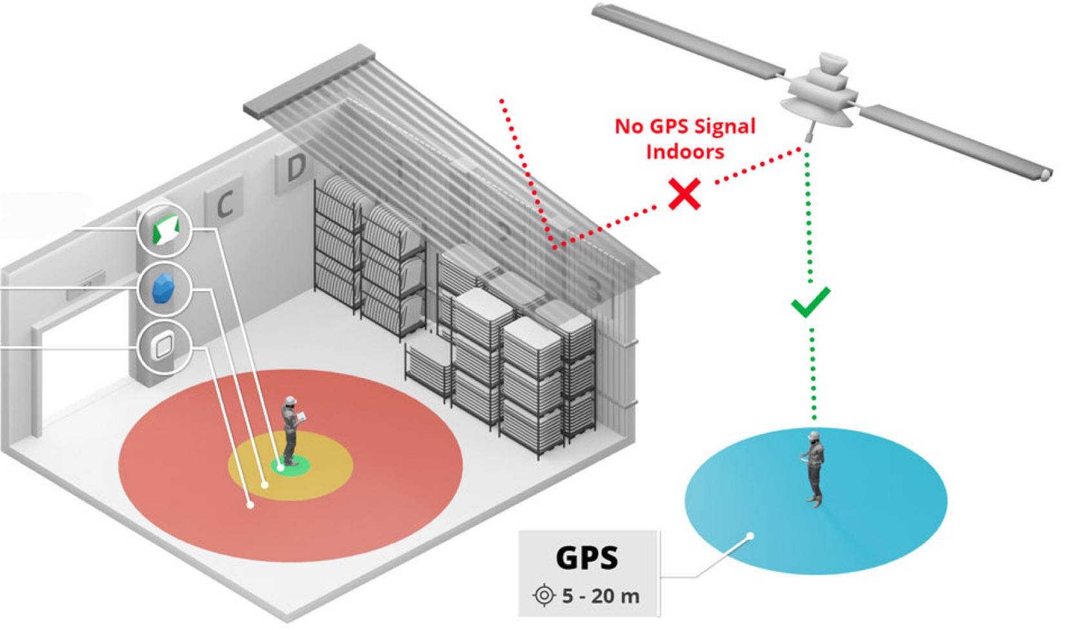
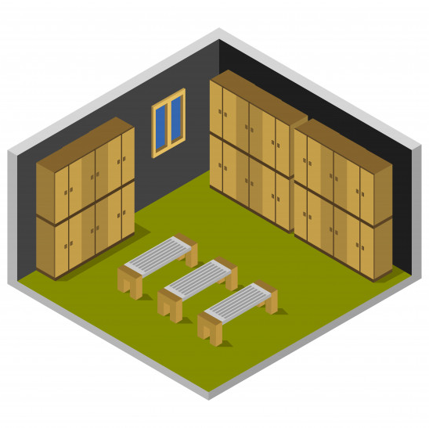
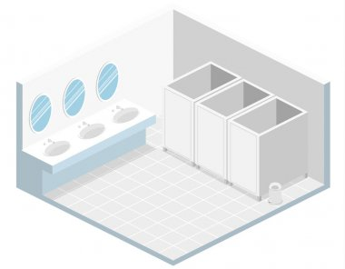
01. Introduction
Limitations of existing human behavior detection
Public
toilet
Fitting
room
Indoor
(GPS)
Some indoor spaces have privacy concerns, and GPS signals do not pass, making it difficult to recognize people's location or behavior.

Slide 4
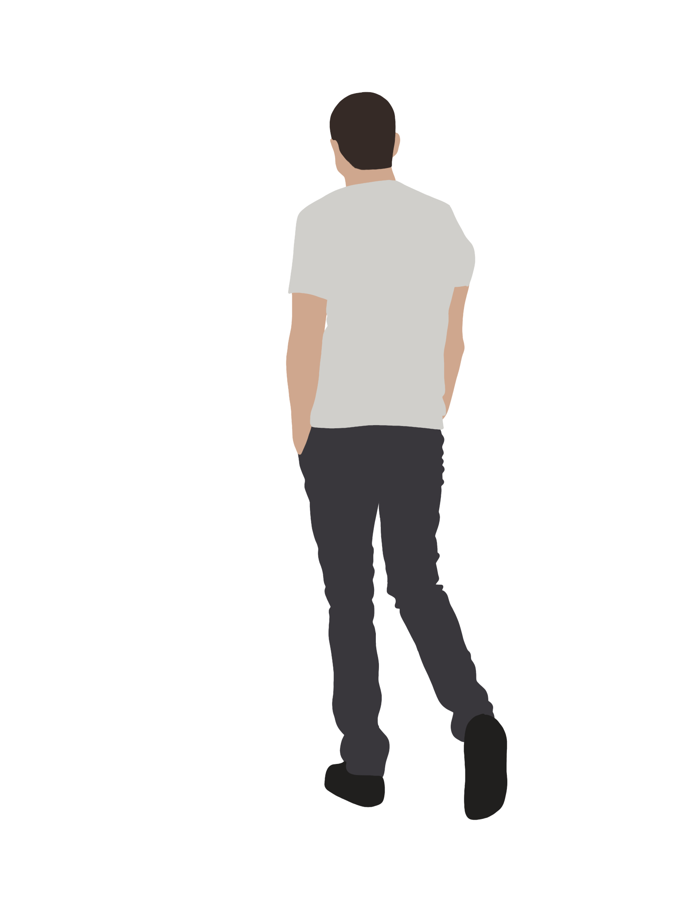



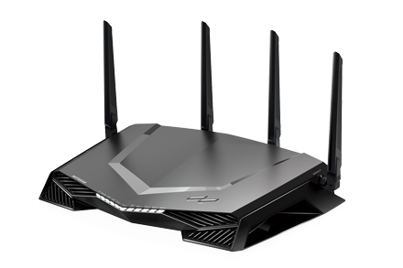
01. Introduction
Wi-Fi Sensing
Sender
Receiver
Technology that analyzes patterns through
Wi-Fi wireless signals measured in the surroundings

Slide 5
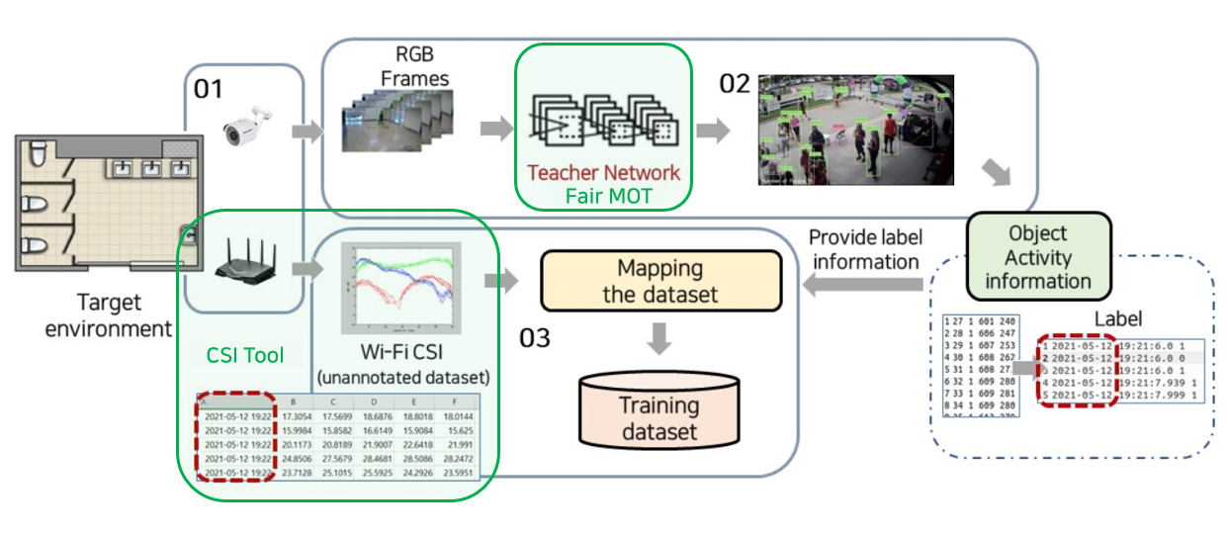
02. Overview
System Architecture
Self-supervised learning is performed by collecting CSI data and vision data in the same environment and labeling the results obtained from the vision data on the CSI data.

Slide 6
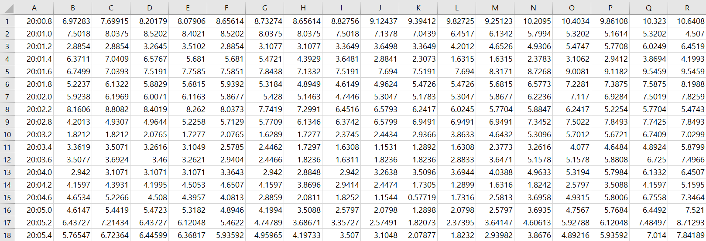
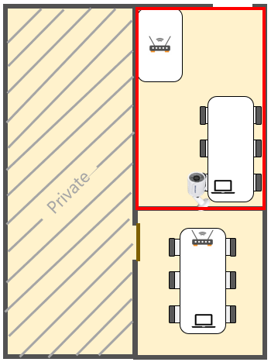

02. Overview
Problem of CSI data
At the time of collection, we must manually assign appropriate labels to each data.
Label
Label
1. Manual labeling is time-consuming
Since the collected data is not labeled, a person must manually assign the correct answer for each situation.
2. It is difficult to collect large amounts of data.
Because labeling is time-consuming and manual work, it is impossible to collect data for various situations.

Slide 7
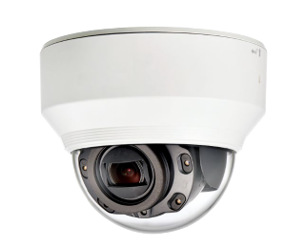
02. Overview
Suggestion idea
A label is automatically provided by deriving the correct answer from the vision data.
Label
MOT
Collect CSI data and vision data at the same time in the same environment.
By placing an object tracking library as a teacher network, the correct answer for the environment in which CSI was collected is automatically mapped to a label.

Slide 8
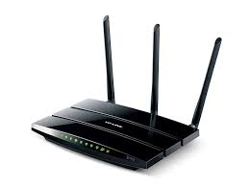
03. Implementation(CSI)
CSI Extraction Setting
Environment
: Use TL-WDR4300 Wi-Fi with 3 antennas and a total of 30 subcarriers
: Ubuntu 14.04.6 LTS, MATLAB R2019a
CSI Tool
802.11n CSI Tool
Intel Wi-Fi Wireless Link 5300 802.11n MIMO radios, using a custom modified firmware and open-source Linux wireless drivers
Real time processing for CSI Tool
A tool that retrieves the extracted CSI data in real time and returns it in the form of a matrix and visualizes it in a graph
Intel 5300 NIC

Slide 9
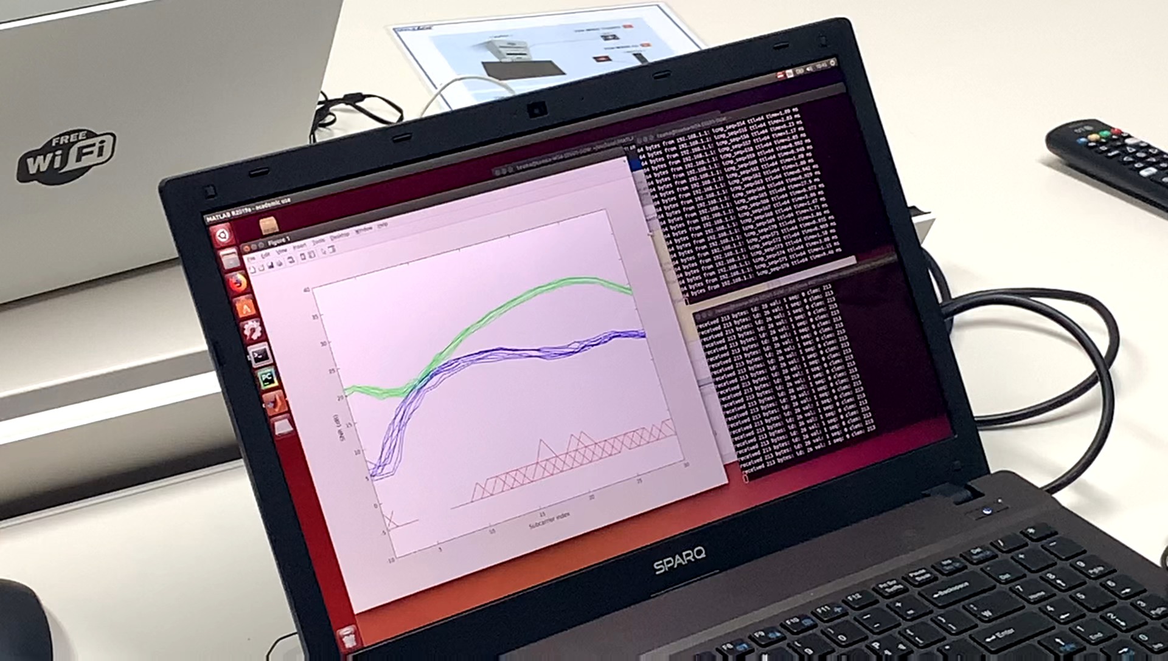
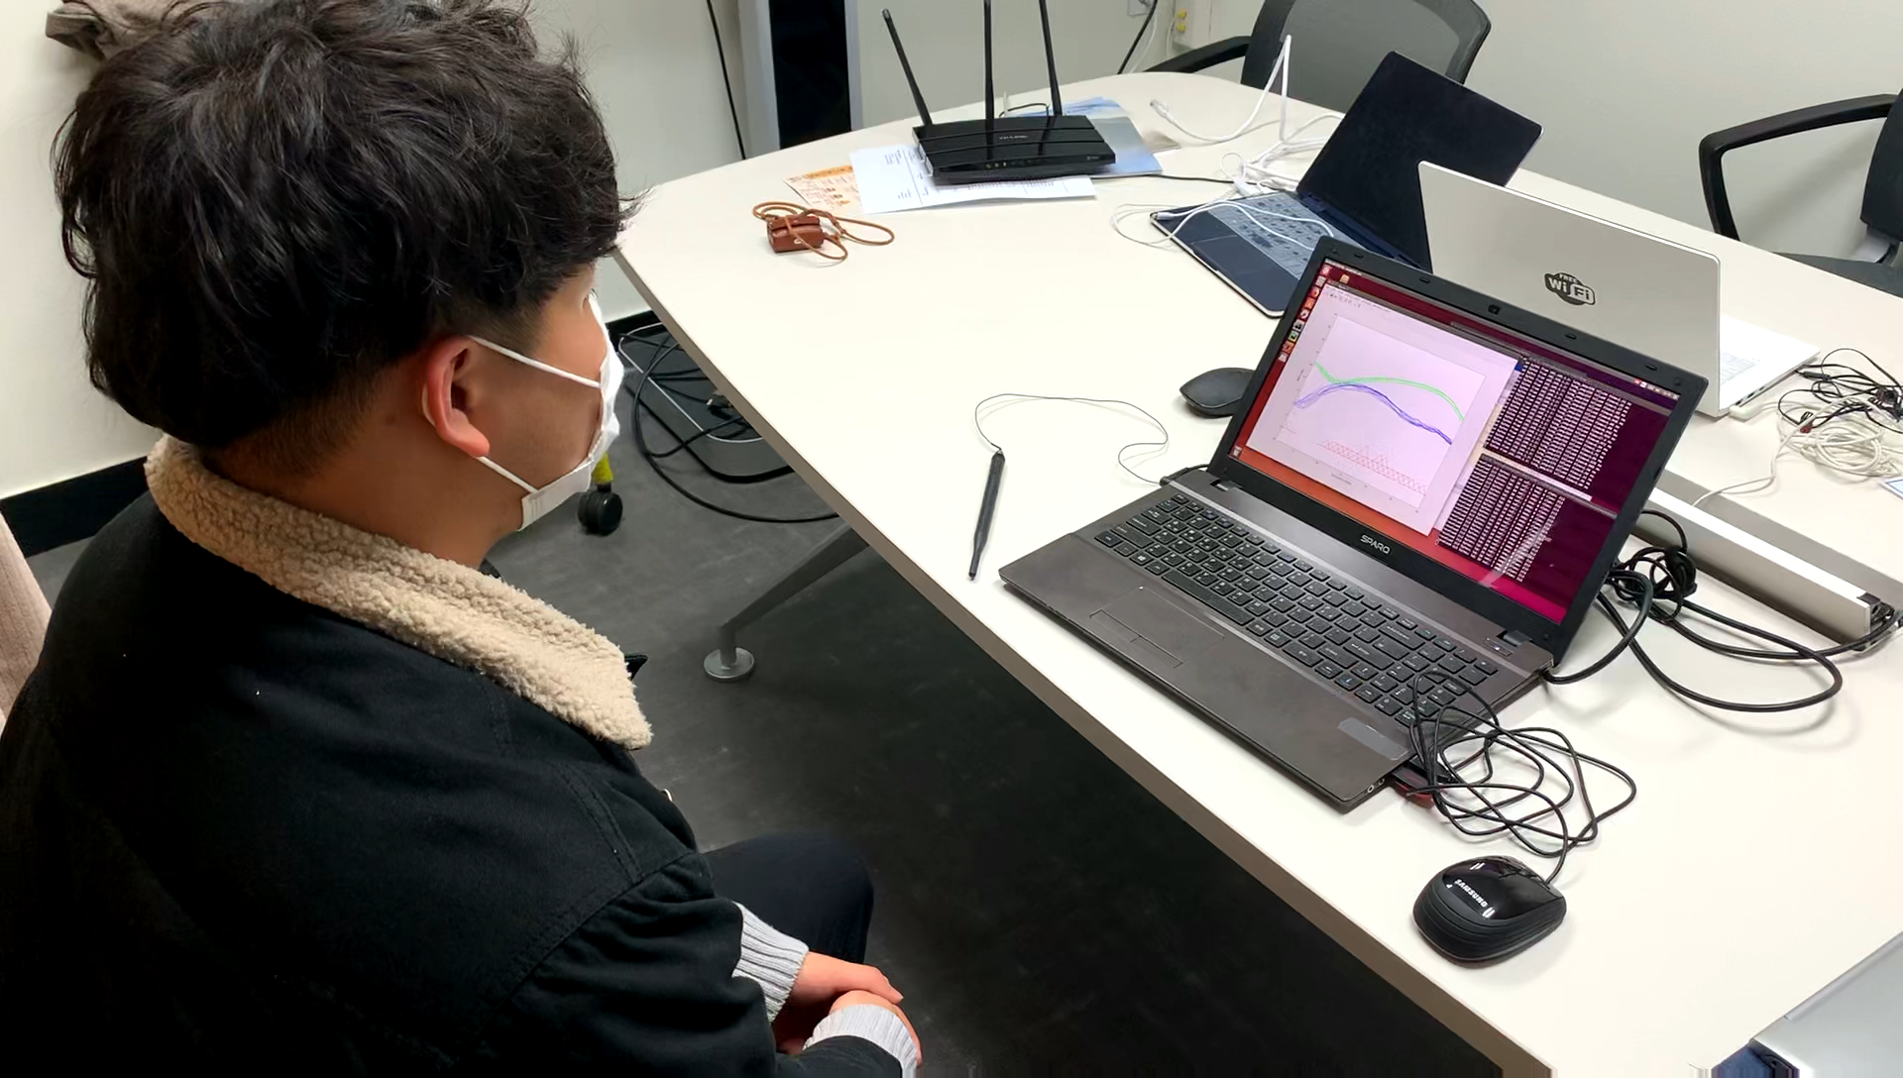
03. Implementation(CSI)
CSI Extraction

Slide 10



03. Implementation(CSI)
CSI Extraction Experiment
3.4 m x 3.75 m

Slide 11
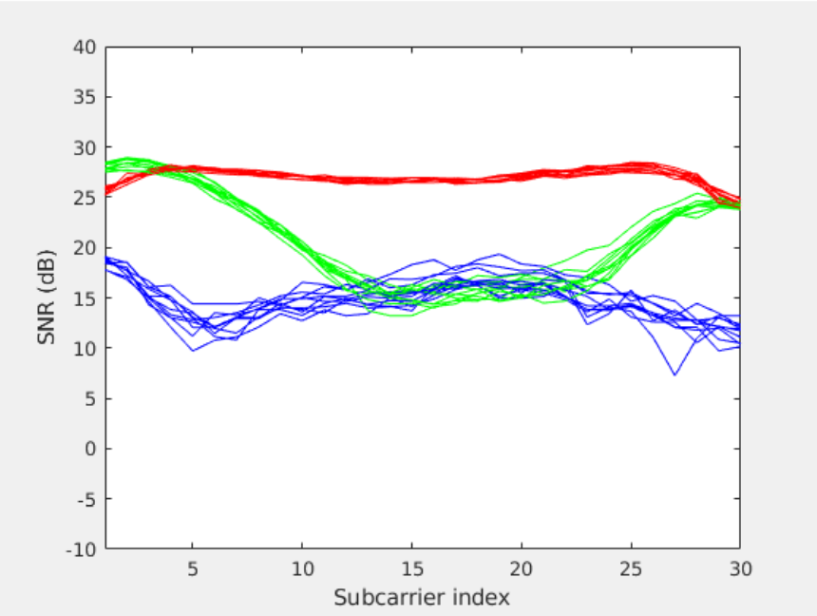
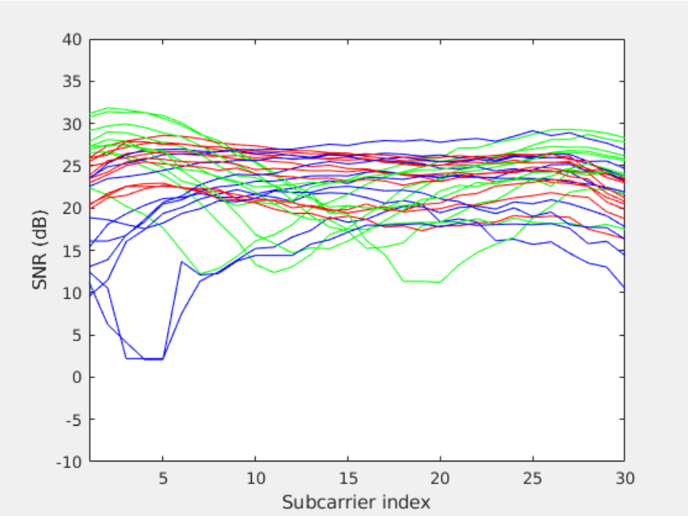
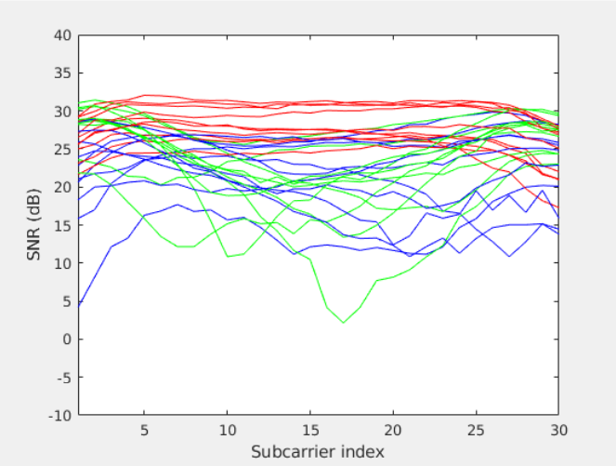
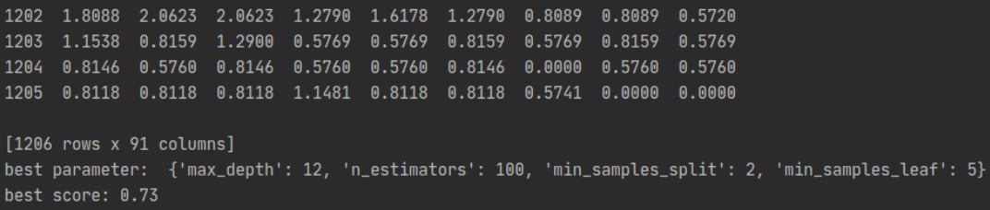

03. Implementation(CSI)
Experiment - People Counting
Label [3]
Label [2]
Label [1]
1 person
2 person
3 person
Random Forest | Data : 1205 row | Accuracy : 73%
Light off

Slide 12
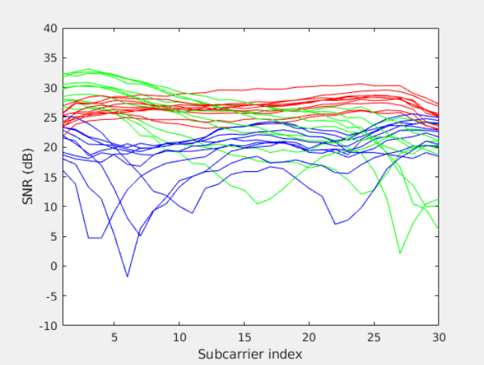
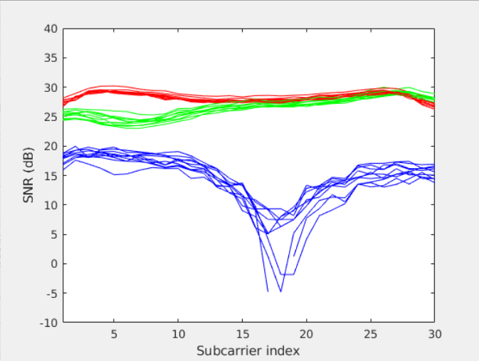
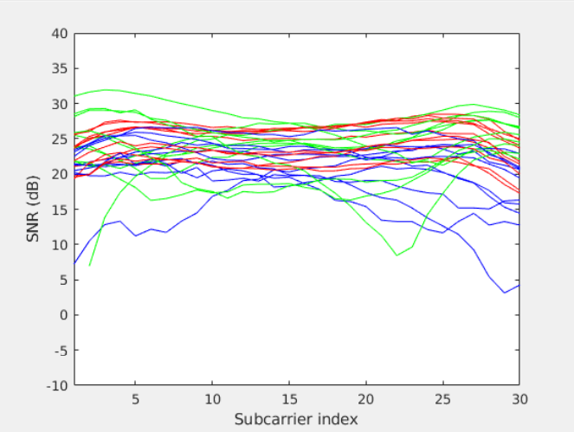
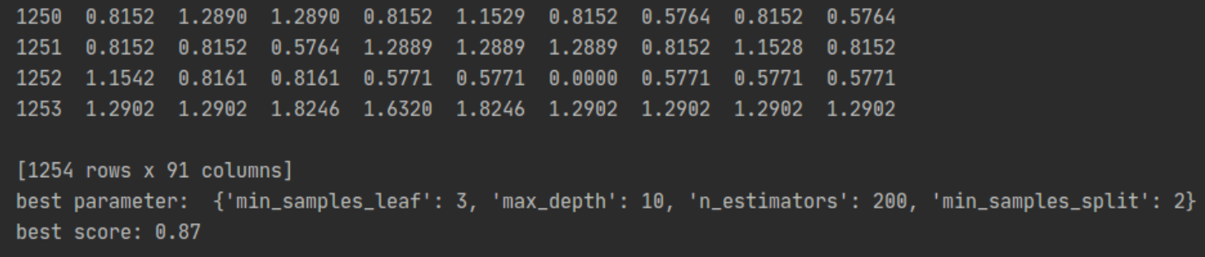
03. Implementation(CSI)
Experiment – Localization 1
Label [1]
Label [2]
Label [3]
Area 1
Area 2
Area 3
Random Forest | Data : 1253 row | Accuracy : 87%
Light off

Slide 13
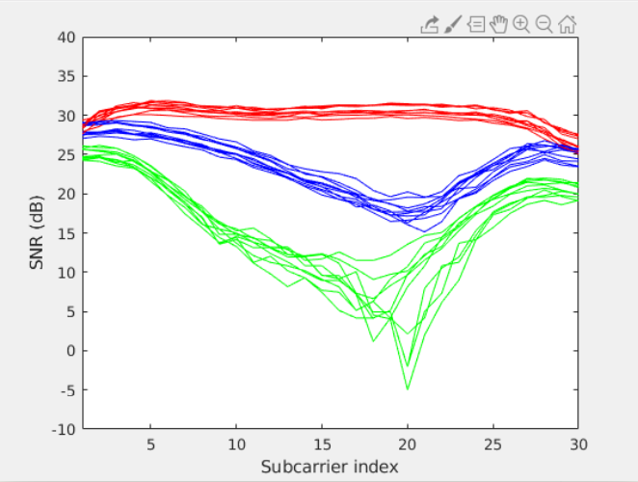
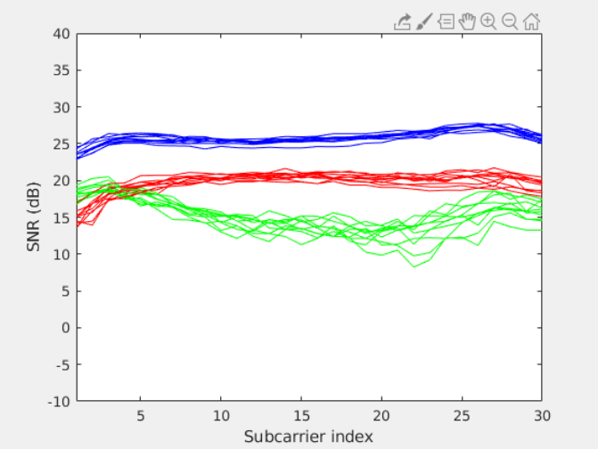
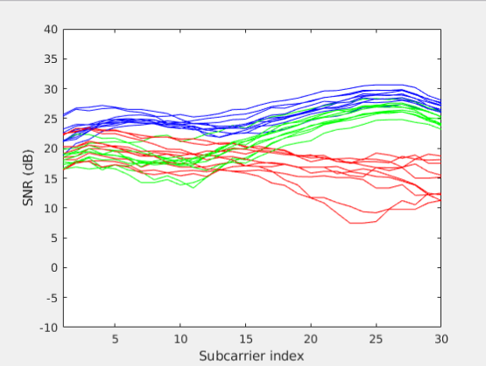
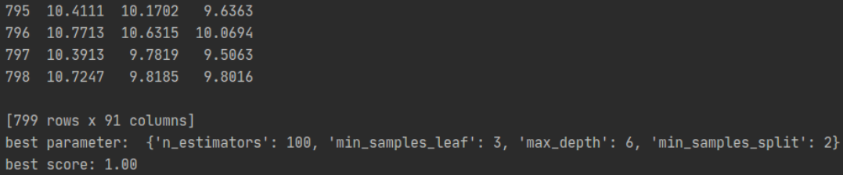
03. Implementation(CSI)
Experiment – Localization 2
Label [3]
Label [2]
Label [1]
Area 1
Area 2
Area 3
Random Forest | Data : 798 row | Accuracy : 100%
Light off

Slide 14
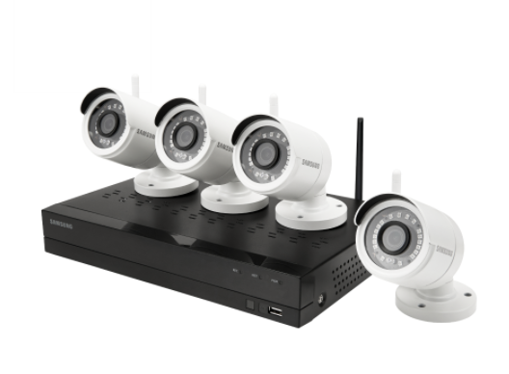
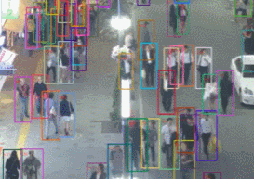
03. Implementation(Vision)
Vision data setting
Environment
: Use 4ch 4cam wireless KIT
(SNK-B73040BW, WISENET)
: Ubuntu 20.04.1 LTS, Python 3.7.9 version
Object detecting tool
Fair MOT
Fair MOT is a high-performance library for multi-object tracking research. In this project, it was used to track the number and location of people in an indoor space.
Each object is marked with a bounding box and is tracked as it moves. Through this, it is possible to check the person information in the recorded video.
Fair MOT

Slide 15
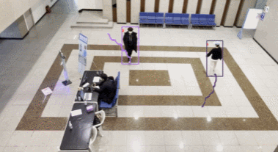
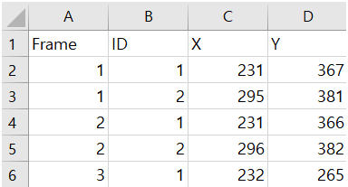
03. Implementation(Vision)
Experiment – Gachon univ. IT building
Gachon univ.
IT building
Tracking result
MOT performance in a high-rise shooting environment
In each frame, an ID was assigned to the person appearing, so the coordinates of the object's position within the frame were consistently well tracked.

Slide 16
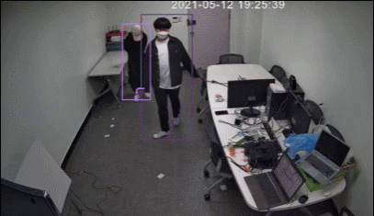
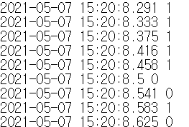
03. Implementation(Vision)
Experiment – In the room
Experiment space
Detection result
MOT performance in low-rise environments
The performance of the MOT taken from a low height was lower than that of the video shot from a high height. The ID given to a person keeps changing every frame, and the tracking performance is not good.
IT building 231

Slide 17
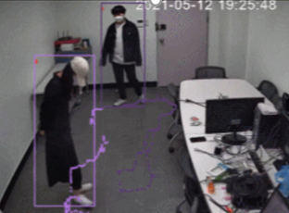
03. Implementation(Self-supervised)
Self-supervised Learning
Key point → timestamp
: In the case of video, time passes in units of frames, and in the case of CSI, CSI data and
measured time information are received only when the ping is returned properly, so a
process of synchronizing the timestamp between the two data is required.
I wanna know the label at this moment !
Is your time the same as mine?
Yes
CSI data
MOT result
Note that this is your label

Slide 18
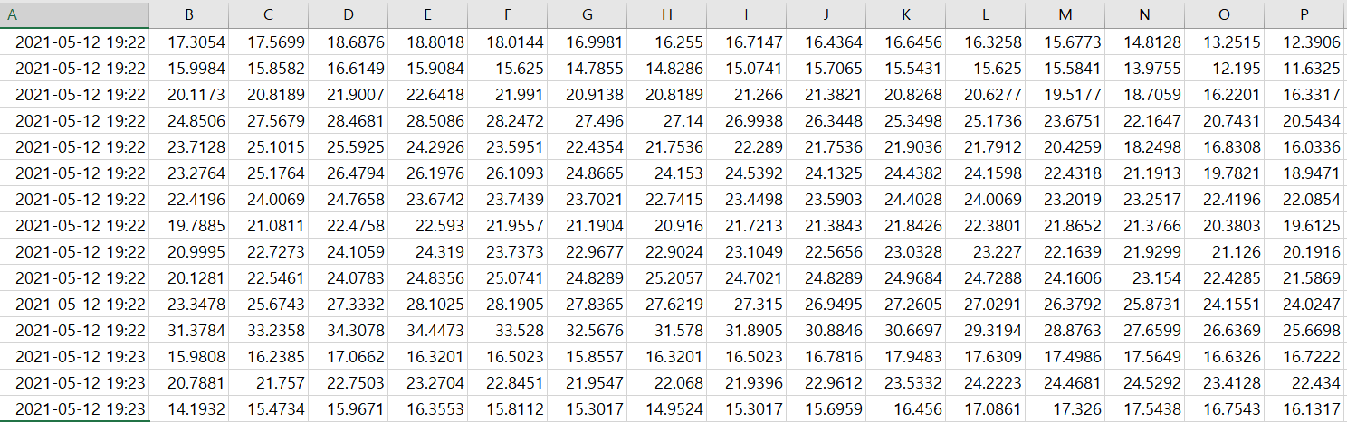
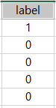
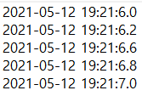
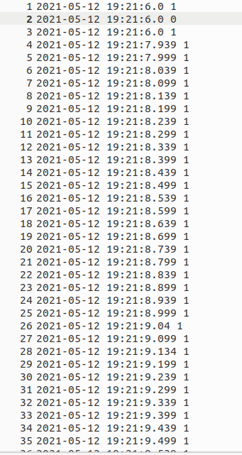
04. Experiment
Self-supervised Learning
Key point → timestamp
: In the case of video, time passes in units of frames, and in the case of CSI, CSI data and
measured time information are received only when the ping is returned properly, so a
process of synchronizing the timestamp between the two data is required.
Label
CSI data
MOT result

Slide 19
04. Experiment
Experiment
PCA(Principal Components Analysis)
PCA is for dimensionality reduction to improve performance.
75%
25%
Train & Test dataset
Training CSI data (90 features → 6 features)

Slide 20
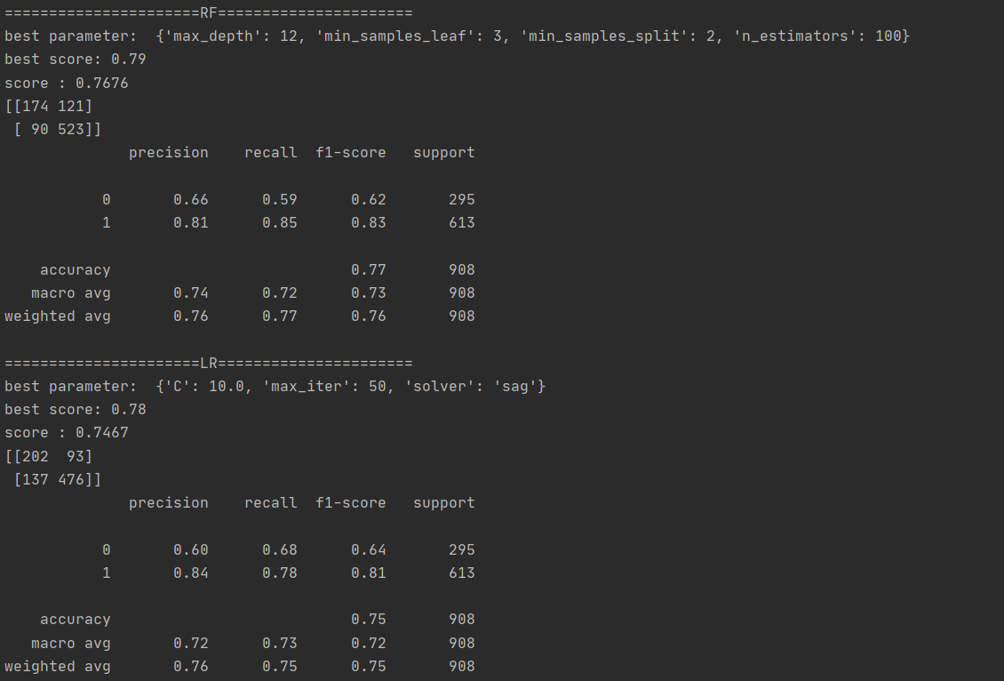
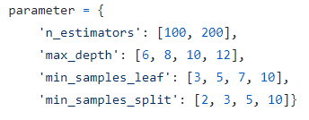
04. Experiment
Experiment 1 - Random Forest
Random Forest & GridSearchCV & Kfold
Random Forest and Kfold are for getting better performance and GridSearchCV is for finding the best parameter of hyperparameter.
Random Forest parameters

Slide 21
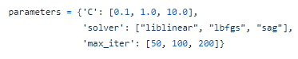
04. Experiment
Experiment 2 - Logistic Regression
Logistic Regression & GridSearchCV & Kfold
Logistic Regression is for checking whether there are people or not, GridSearchCV is for finding the best parameter of hyperparameter, and Kfold is for getting better performance.
Logistic Regression parameters

Slide 22
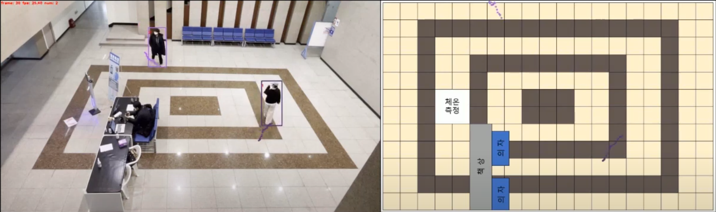
05. Appendix(BEV)
Bird Eyes View Mapping
Transform Vector

Slide 23
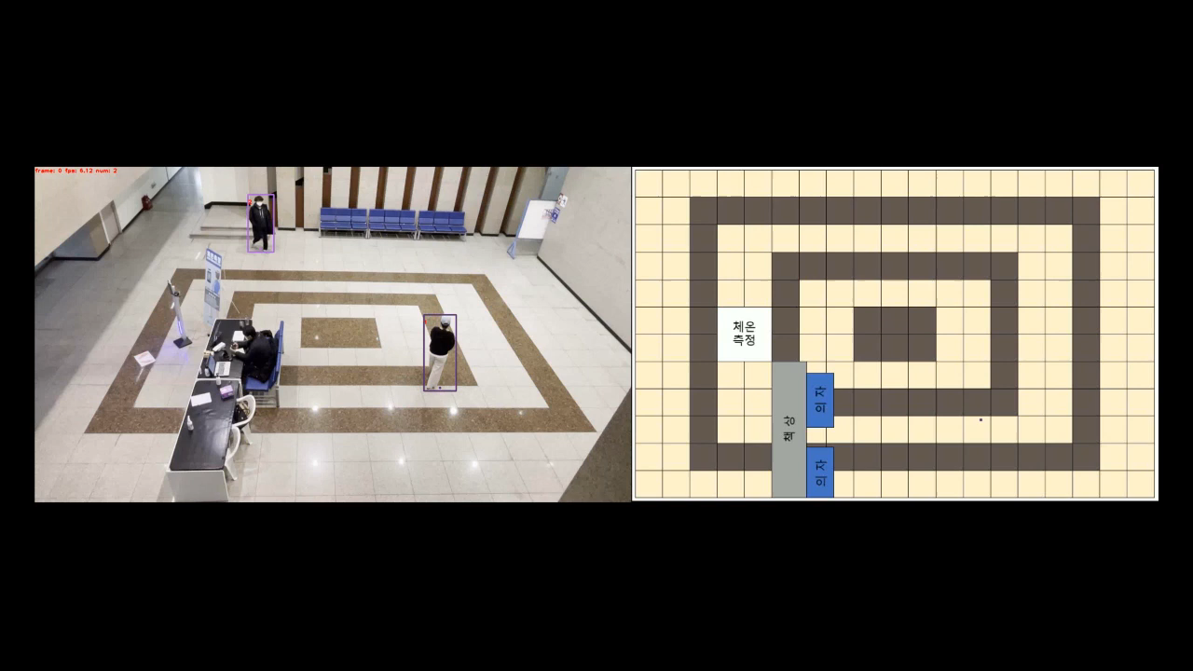
05. Appendix(BEV)
CSI Localization - FairMOT

Slide 24
05. Appendix
CSI Localization - FairMOT
CSI Localization
Object Detection
People Counting

Slide 25
06. Marketing Plan
CSI (SWOT)
S
W
Low Cost
No invasion of privacy
Unaffected by lighting
Difficult to extract
Special modules required by the receiver
No Dataset
Deep learning models are applicable
Labeling with Self-supervised is possible
Anywhere Wi-Fi device
Difficult Labeling
Possible distortion of Wi-Fi signals
O
T

Slide 26
06. Marketing Plan
Vision-MOT (SWOT)
S
W
High accuracy
Many datasets exist
Various research are under way.
Highly affected by lighting
Expensive camera costs
It is applied in a variety of areas
Launch camera with good performance
privacy concerns
O
T

Slide 27
06. Marketing Plan
Self-Supervised learning (SWOT)
S
W
Time-dependent
Overcome fewer datasets
Overcoming the difficulty of labeling
Applicable in a variety of areas
Potential for improvement through research
Accuracy to be lower than before
O
T

Slide 28
06. Marketing Plan
Self-Supervised Learning - Marketing Plan
Marketing Plan
Feature
: We overcame the problem with CSI Data that was difficult to label by automatically labeling through self-supervised learning.
Target
: CSI Researcher
Concept
: it is easy to label CSI Data.
Strategy
: Self-supervised learning makes CSI Data easier to train. As a result, this feature can be used in future CSI studies and will be helpful to many researchers.

Slide 29

Thank you

